Slide 1
Star War Game
Team Members:
Hu Xiaowei 1155082903
Wang Xi 1155083228
Lin Huangjing 1155072677

Slide 2
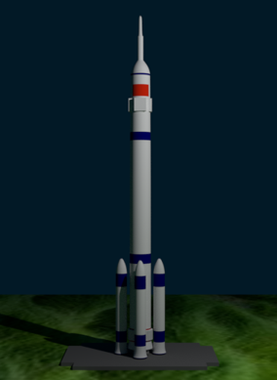
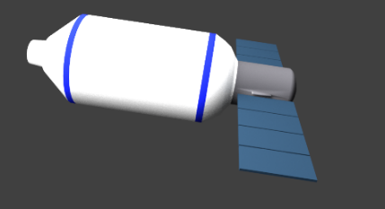

Our Previous Work

Slide 3
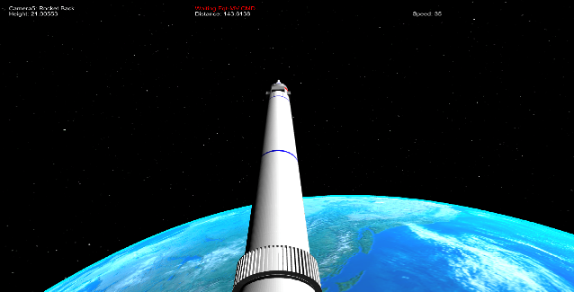
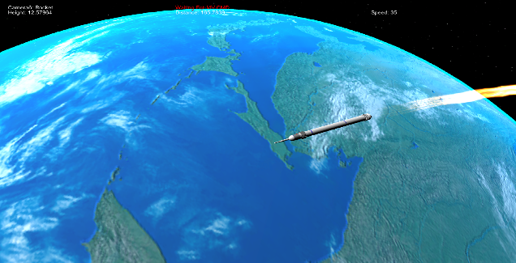
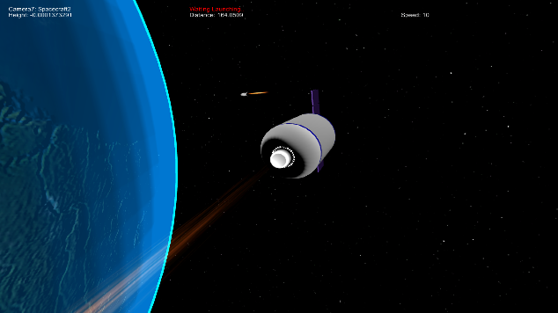
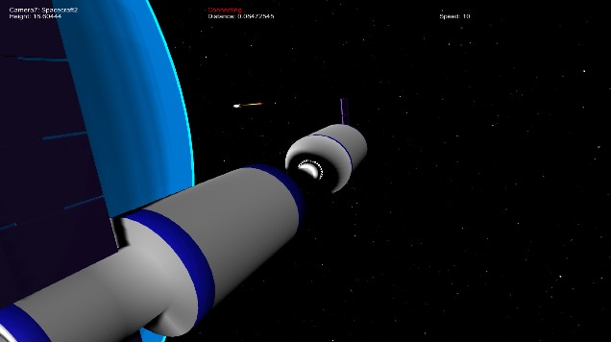
Our Previous Work

Slide 4
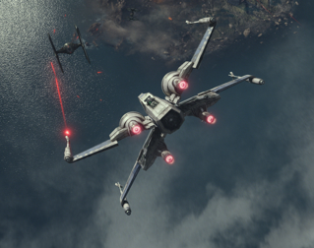
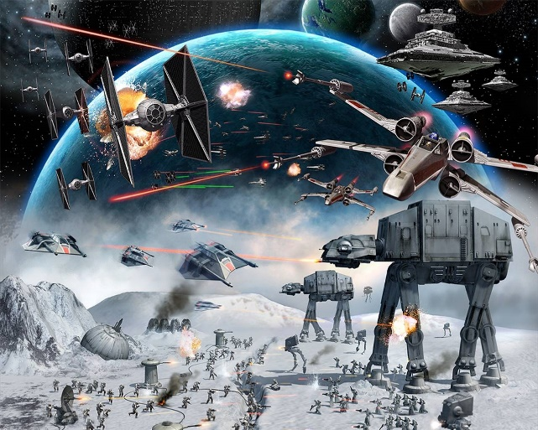
Star War Game

Slide 5
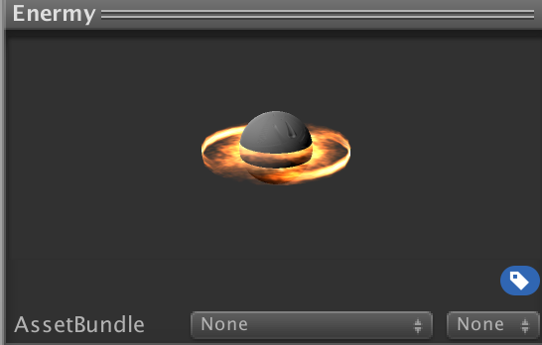
Star War Game
UFO Model Design

Slide 6
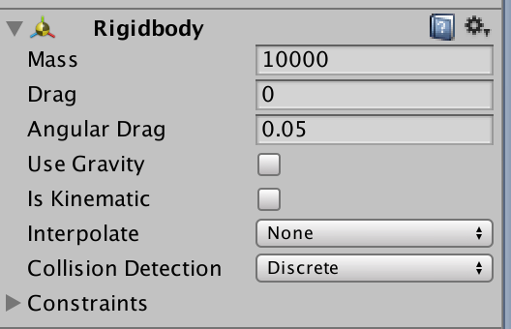
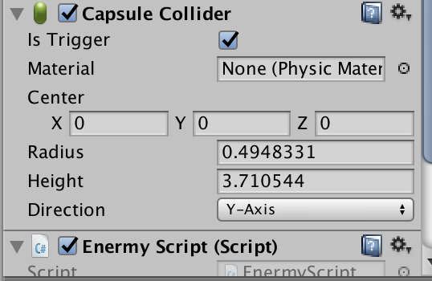
Star War Game
UFO Model Design

Slide 7
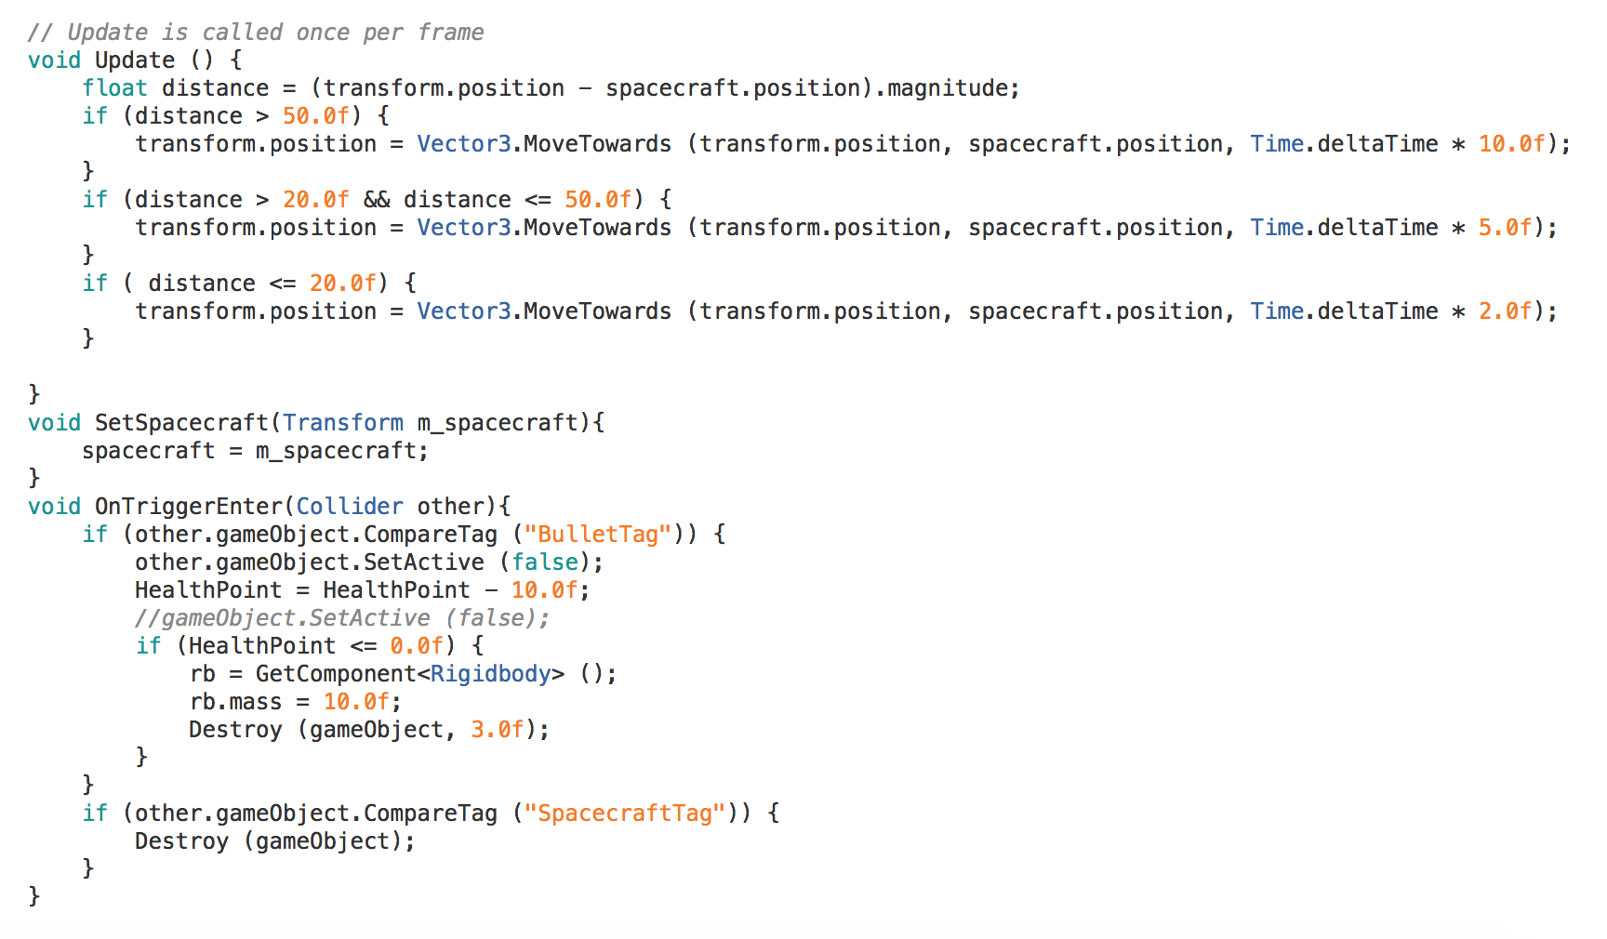
Star War Game
UFO Model Design

Slide 8
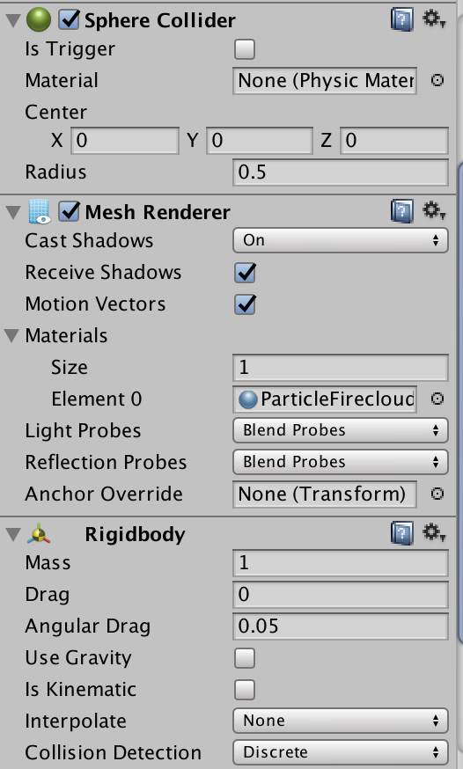
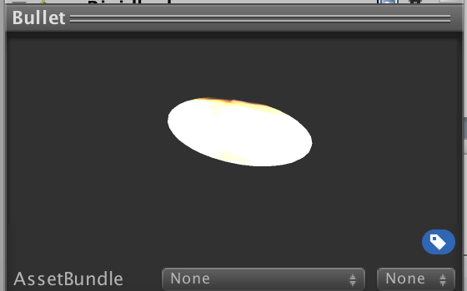
Star War Game
Bullet Model Design

Slide 9
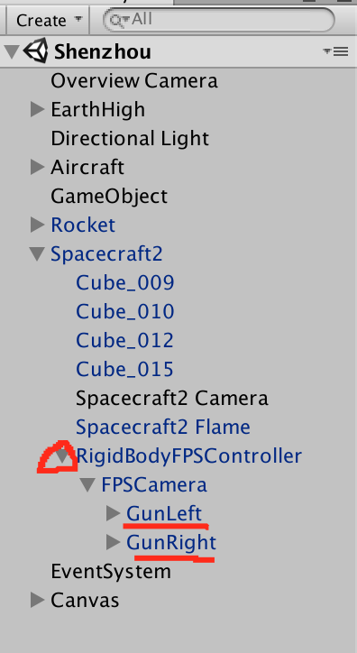
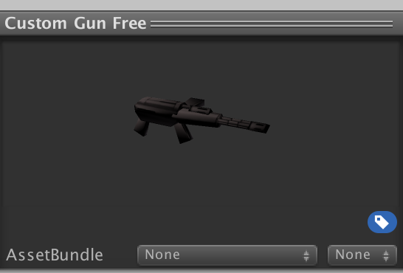
Star War Game
Machine Gun Design

Slide 10
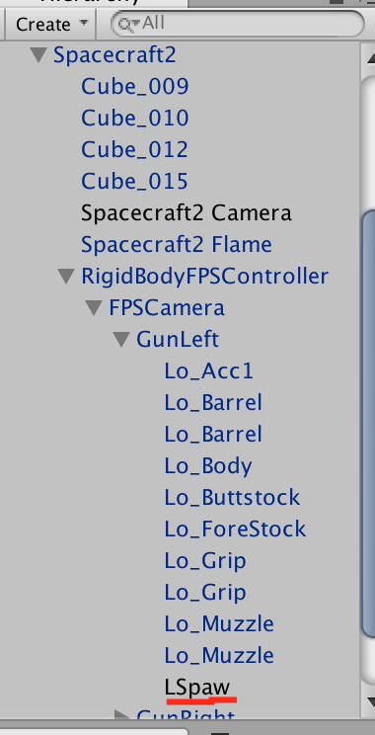
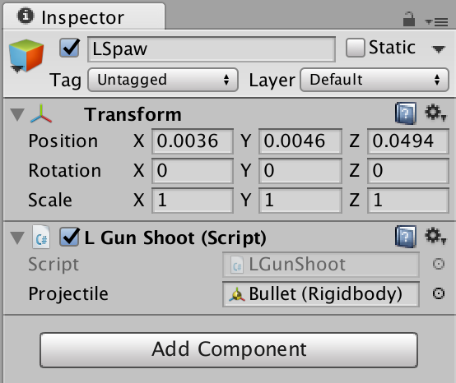
Star War Game
Machine Gun Design

Slide 11
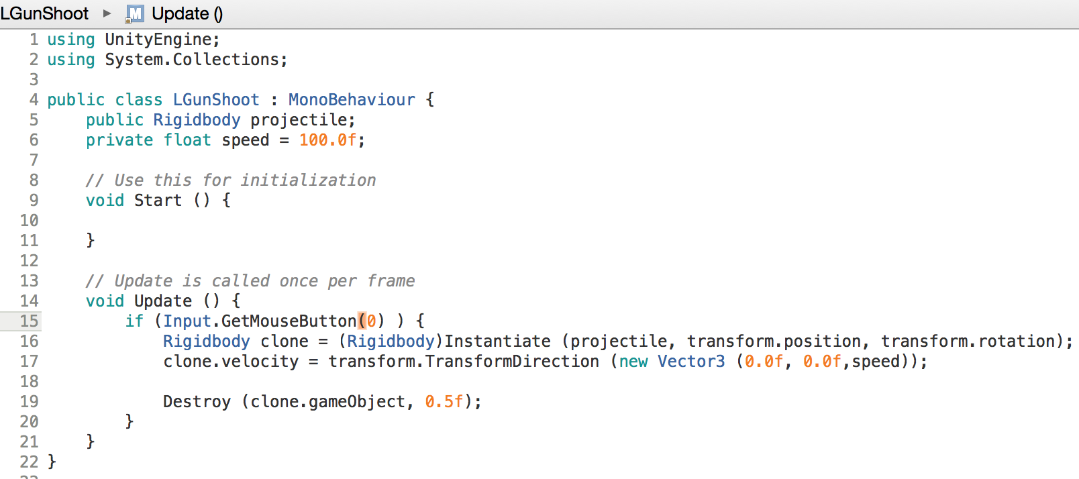
Star War Game
Machine Gun Design

Slide 12
Star War Game
Collision Control
Detect Collisions
UFO

Slide 13
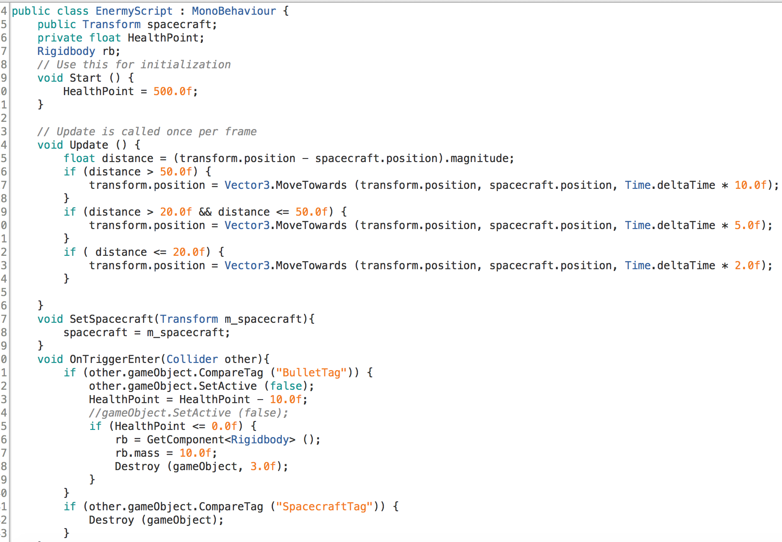
Star War Game
Collision Control

Slide 14
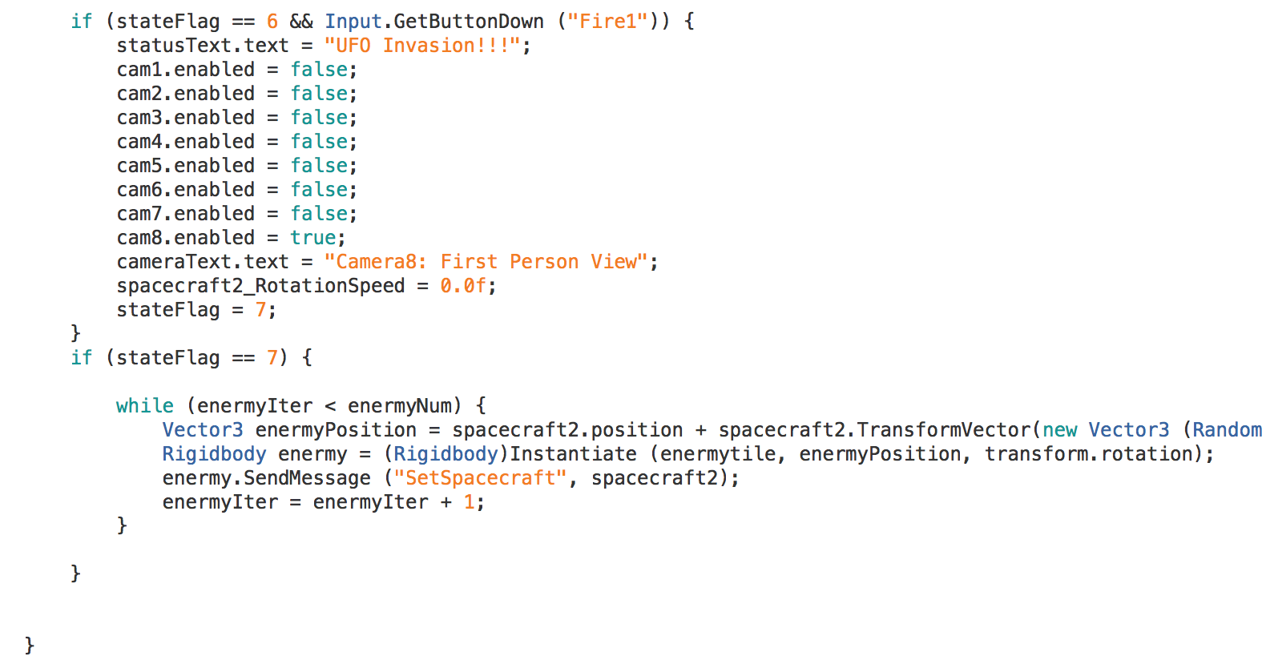
Star War Game
Main Process Control

Slide 15
Star War Game
Demonstrate Our Project

Slide 16
Thank you

